Slide 1
SSDT Database Projects
More than just source control

Slide 2








About me
SQL developer since 2006
Current employer: GoInspire
chris.johnson.0120@gmail.com
Blog: www.allthezerosmatter.com
GitHub:
Specialisms: BI, DevOps
Please contact me with any questions

Slide 3
What this talk is about
SSDT/Visual Studio Database Projects
More than source control
Turn your database into a code project
Validation
References
Variables
What does all of this let you do?

Slide 4
Installation
Up to 2017 part of SSDT/BIDS
Installed to existing Visual Studio/created Visual Studio Shell
Part of SQL Server installation/free stand-alone instance
2019+ integrated into Visual Studio
Component under Data Storage and Processing
SQL Server Data Tools
Visual Studio Community at home/paid version at work
2017 can do either
https://docs.microsoft.com/en-us/sql/ssdt/download-sql-server-data-tools-ssdt?view=sql-server-ver15

Slide 5
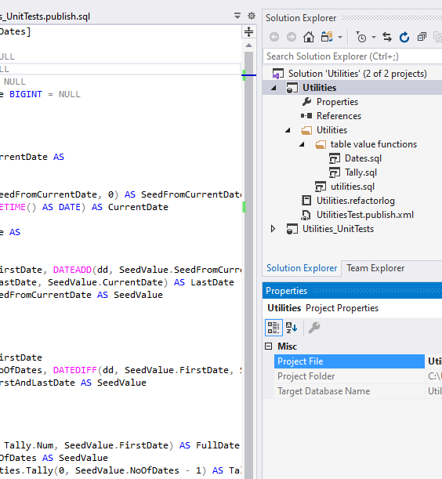
What does this look like?
Solution
Project
Project properties
References area
Code file
Refactor log
Project
Code window
Properties box

Slide 6
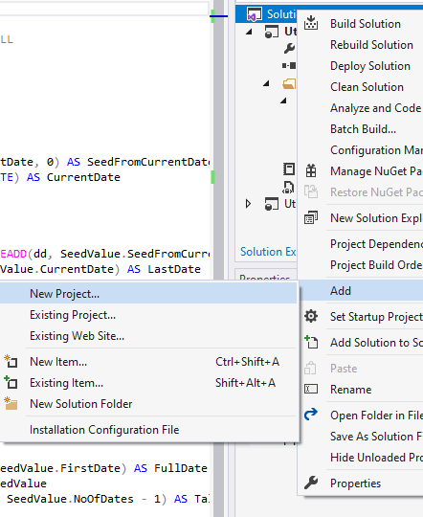
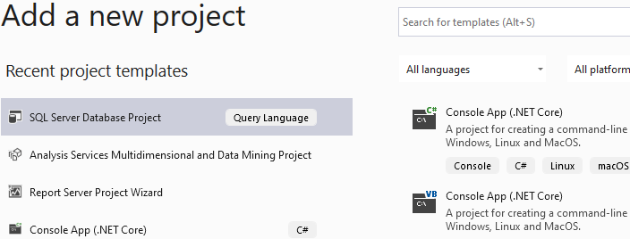
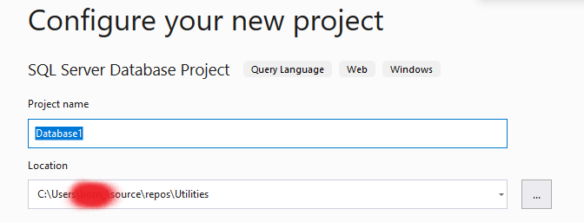
Importing an existing database
Notes:
Add a new database project. You can only import an existing database to a new project, once you add something to the project you lose that ability.

Slide 7
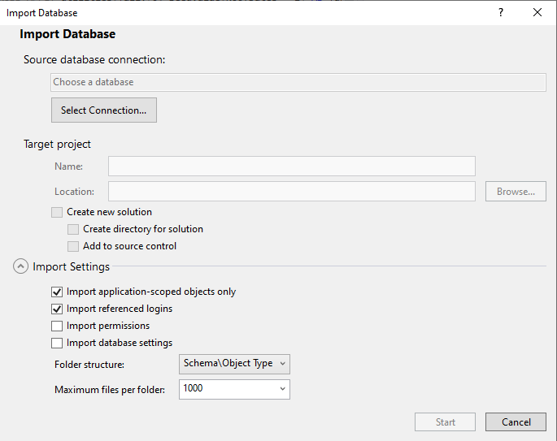
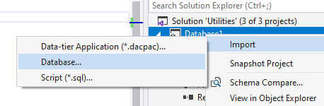
Importing an existing database
Standard db connection options
Greyed out, we have already defined the target project
What to import
How to structure the folders
Notes:
Add a new database project. You can only import an existing database to a new project, once you add something to the project you lose that ability.

Slide 8
What have we done here?
Taken the database code out of the database
Made it a code project instead
This is the central idea that distinguishes Visual Studio database projects
More than source control
Turns the database into a project
Same way as SSIS
Deployed SSIS package is xml
Project version has UI, validation, deployment options etc.

Slide 9
Writing code for a database project
Always edit code in the project, not on the database
Project is now the shared code base for the team
Otherwise your changes can be overwritten
Click on a script and it opens in Visual Studio
Edit mostly just like in a db
Does have intellisense
Everything should be a CREATE, never ALTER
Renames/refactors should be done through the interface (more on this later)
Can reference other projects (more on that later)

Slide 10
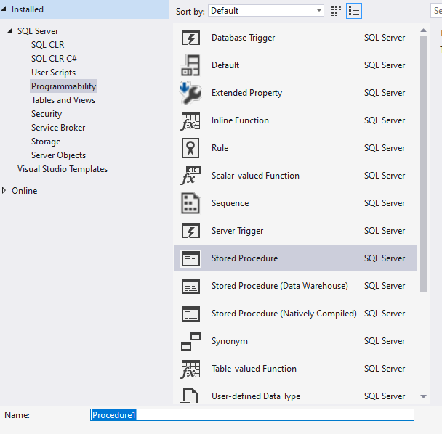
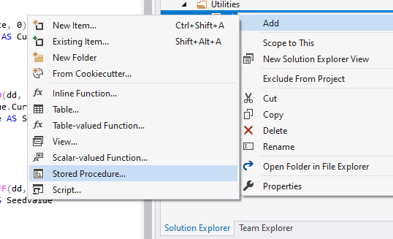
Adding a new object

Slide 11
Adding a new object
Generates a file with a template for the object
All files are .sql
Nothing makes that file a particular object type apart from the code
Nothing makes that file a particular object apart from the code
Names of files do not necessarily match the object they contain
Objects default to default schema (e.g. dbo) in the template code
To change this, include the schema in the name when you create something
Schema will not be included in the file name, but the template code will include it

Slide 12
Other objects you can include
Users
Logins
Specify password for create only
Linked servers
SQL Agent jobs
Cover this in more detail in pre/post deployment scripts
Database settings
Notes:
Server level objects get odd. There is no option to deploy them without a db, but they will affect the whole server.

Slide 13
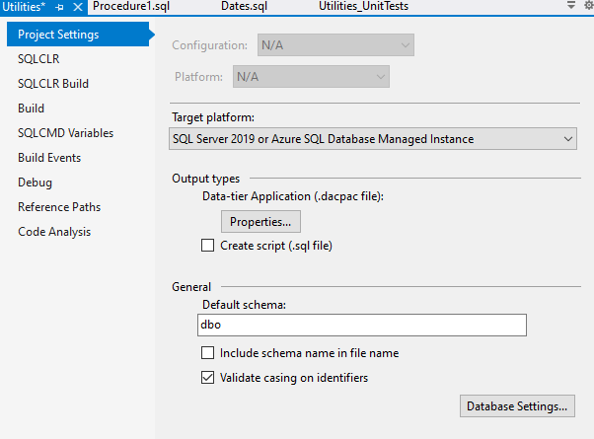
Project properties and database settings
Target SQL version
Expand on this in next slide

Slide 14
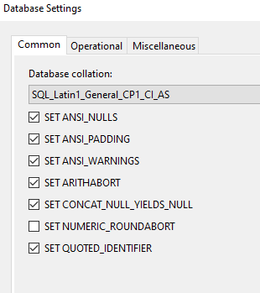
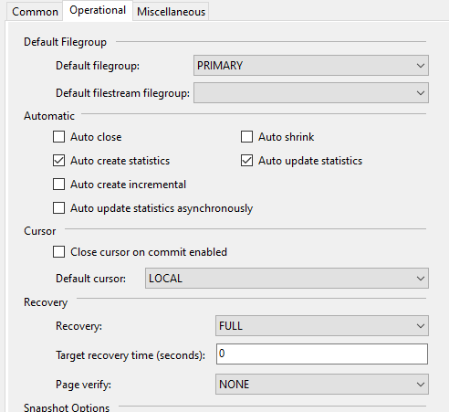
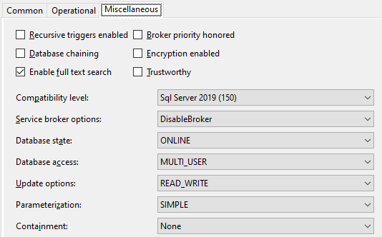
Project properties and database settings
Lots of options here
You do not have to include all of them
Notes:
If you want to e.g. manage your recovery model through Management Studio instead, you can. That is probably sensible, as your recovery model may differ depending on the environment you deploy to.

Slide 15
Dacpac: what is it?
.dacpac:
A file extension
File is used as a deployment artefact
Also used for other things (discussed later)
Combination of all scripts to summarise the database code
Like dll from C# library project/xml from SSIS
Generated/Updated when you build the project
Project has to build to be deployable

Slide 16
Deployment
All deployments come from the .dacpac file
Simplest approach is to publish through Visual Studio
But this is not very automated
Can also deploy with Powershell
Or command line
Note: databases and projects can have different names
So can deploy several versions of the database to the same server
Or have the same database named different things on different environments

Slide 17
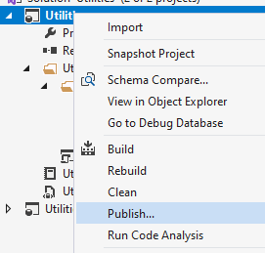
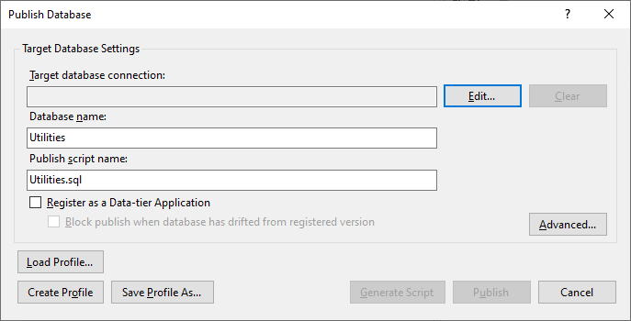
Deployment within Visual Studio
Connection to server
Save profile to re-use settings
Generate script or publish
DB to target with deployment
Advanced setup options

Slide 18
Deployment using code
Command line
Need SqlPackage.exe on the machine
Navigate to it
SqlPackage.exe /Action:Publish /SourceFile:“[filepath]\[filename].dacpac” /TargetDatabaseName:[TargetDBName] /TargetServerName:“[TargetServerName]”
Powershell
Bit more complex to start with
add-type -path "C:\Program Files (x86)\Microsoft SQL Server\140\DAC\bin\Microsoft.SqlServer.Dac.dll"

Slide 19
Deployment using code
Powershell
Bit more complex to start with
add-type -path “C:\Program Files (x86)\Microsoft SQL Server\[SQL version number]\DAC\bin\Microsoft.SqlServer.Dac.dll”
$dacService = new-object Microsoft.SqlServer.Dac.DacServices "server=[Server name];Integrated Security=True“
$dp = [Microsoft.SqlServer.Dac.DacPackage]::Load(“[Folder path]\[File name].dacpac")
$dacService.deploy($dp, "Example0_PowershellDeploy", "True")

Slide 20
Deployment using code
Powershell
Also can publish instead of deploy, which has more options
Replaces $dacService.deploy line from previous slide
$dacOptions = new-object Microsoft.SqlServer.Dac.DacDeployOptions
$dacOptions.BlockOnPossibleDataLoss = 'FALSE'
$pubOptions = new-object Microsoft.SqlServer.Dac.PublishOptions
$pubOptions.GenerateDeploymentScript = $true
$pubOptions.DatabaseScriptPath = “[Path for generated script]“
$pubOptions.DeployOptions = $dacOptions
$dacService.Publish($dp, "Example0_PowershellPublish", $pubOptions)
Notes:
Still need to have created the DacService ($dacService) and DacPackage ($dp) objects in the previous script

Slide 21
What does this deployment actually do?
Compares .dacpac with database (if it exists)
Generates a SQLCMD script to deploy any differences
SQLCMD includes variables and other functionality
Can be run in a regular SSMS tab by going to Query>SQLCMD Mode
Can just generate script on deployment
Code or Visual Studio
Table changes
Raises an error if data loss may occur – can override this
Can copy data to a temporary intermediate table to check everything

Slide 22
Important deployment settings
Mostly in the Advanced section
General
Block incremental deployment if data loss might occur
Back up database before deployment
Drop
Drop objects in target but not in source
Exclude various object types from this e.g. logins
Ignore
Various object types to ignore from deployment altogether

Slide 23
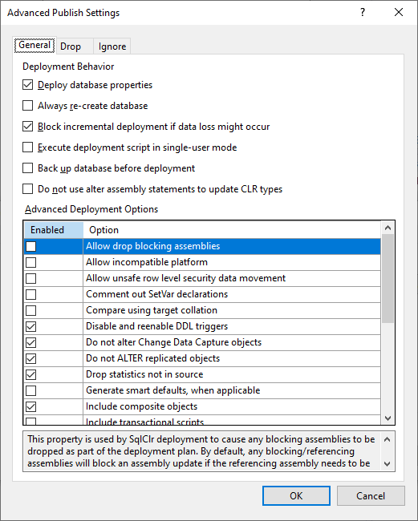
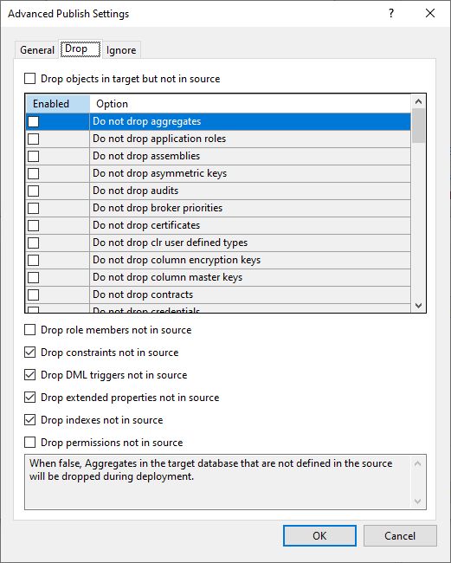
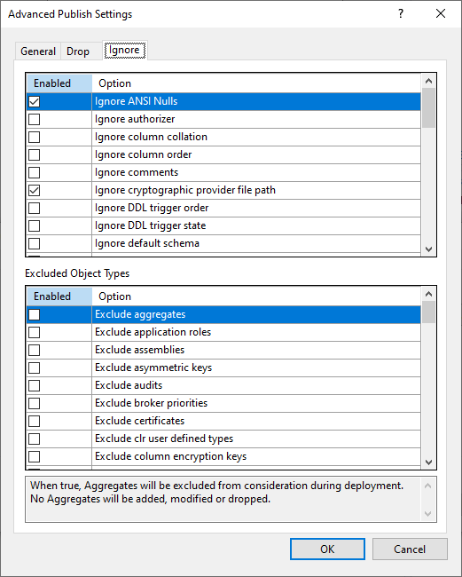
Important deployment settings

Slide 24
Deployment issues
Something wrong in the code
Can be code is incompatible with database setting e.g. SQLCLR and trustworthy
Could be a variable is set incorrectly
Should get an error message that is at least partially descriptive
Referenced files don’t exist
Can reference other files in pre/post deployment scripts
Changes to [X] may introduce runtime errors in [Y]
[Y] has not been included in your deployment
Code cannot validate deployment, so does not do it
Nothing can be done about this, other than include [Y] in your deployment

Slide 25
References and variables
Validation only covers what is in the project
But databases reference other databases
Reference other projects from your project
Tells your project to include other projects in its validation
Actually looks at .dacpac file
Brings dacpac into current project’s bin folder
Also, databases can be deployed with different names
So references are variables by default

Slide 26
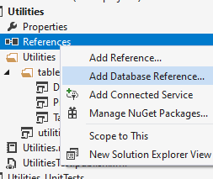
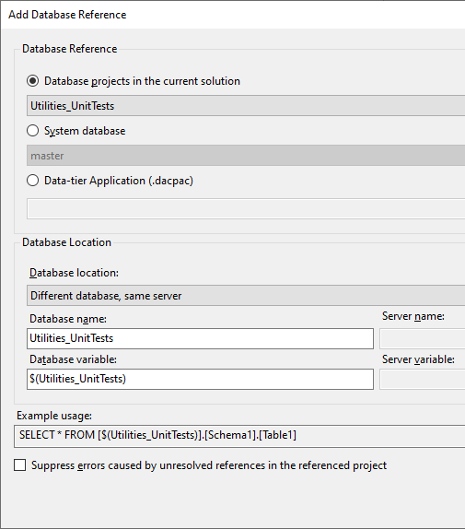
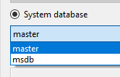
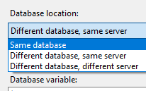
References and variables

Slide 27
Other database reference types
System databases
Master/msdn
Version-specific dacpacs added to this project’s folder
If SQL version changes in project settings, need to delete and re-add references
Required for references to e.g. sys.tables
Databases external to project
Reference to .dacpac file
Relative path
Works if everything is in the same source control repo
Same database references – cover this later

Slide 28
Reference quirks
Reference chains
Attempts to rebuild all referenced projects in current solution
Will fail if referenced project references other projects
Therefore parent has to reference all projects on the chain
Does not rebuild anything from referenced projects in other solutions
If referencer does not pick up something in referencee, rebuild referencee
Circular references
Projects A and B both reference each other
Fails as neither can build until the other does

Slide 29
Variables
All server references have to be variables
Database references can be absolute
Variables appear in code as: [$(VariableName)]
Replaced on deployment, even inside strings
Once a variable is created it lives in the project until deleted in properties
Can create other variables in properties window
Standard variables also available
DatabaseName – most useful
DefaultFilePrefix, DefaultDataPath, DefaultLogPath

Slide 30
The extras
Validation
Pre/post deployment scripts
Refactor log
Deployment actions
Misc
Modular approach to building databases

Slide 31
Validation
Uses intellisense to validate code
Compares to rest of code in project
Build will fail if there are errors anywhere
Double click on error to jump to the troublesome script
When you first import a database there can be thousands of these
Not always as bad as it looks – one error can generate many messages
Database properties affect this:
Build>treat Transact-SQL warnings as errors/Suppress Transact-SQL warnings
Code analysis: lots of options for extras to add – warnings only
e.g. avoid SELECT * appears anywhere
e.g. use ISNULL on NULLable columns in expressions

Slide 32
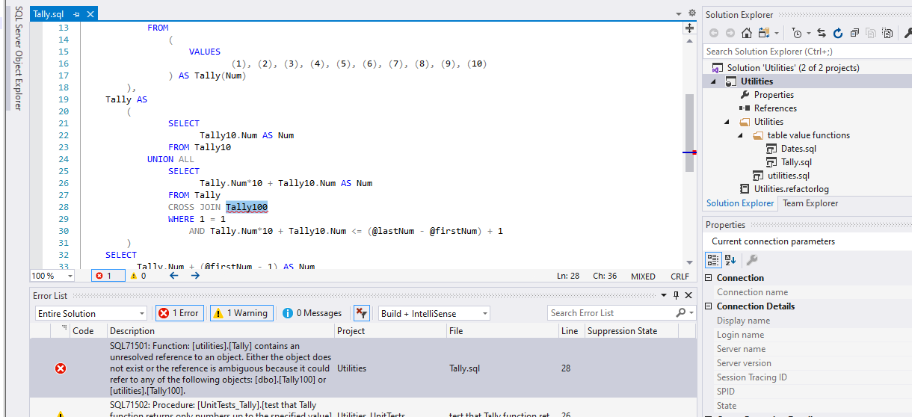
Validation example

Slide 33
Pre/post deployment scripts
Special types of script, only one per project
Runs before/after the main script
main script generated before these run
Usually used for populating fixed data in tables – MERGE statements
Can also be used for other things:
SQL Agent jobs
Running tests
Can execute other scripts in the project using SQLCMD notation
:r .\relativefilepath\filename.sql

Slide 34
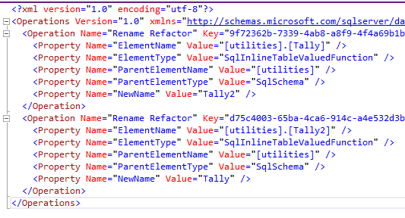
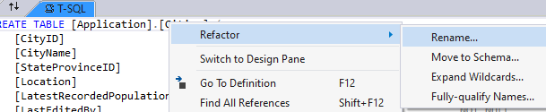
Refactor log
Holds renames, change of schema etc.
Anything that requires a change in place
Uses system table to track changes + decide what to rename
Only records if done through UI
Right click on object + refactor
Rename in table designer
Mostly applicable for tables
Refactor action also propagates through code
Notes:
Refactor includes: rename, move schemas, expand wildcards i.e. select *

Slide 35
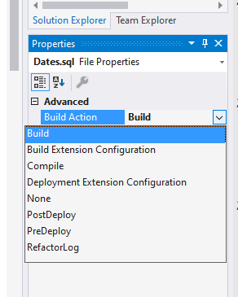
Deployment actions
How does the project know what is the refactor log/post deployment script/non-build script etc.
Each script has a Build Action property
Build – include in build
None – do not include in build in any way
Pre/PostDeploy + Refactor log
Everything else not used
‘None’ scripts can be referenced in Pre/PostDeployment
‘Build’ scripts have to create an object
Only way to do data manipulation

Slide 36
Misc
Comments in tables
Keep source code for encrypted objects
Folder structure for your objects
Recommended is Schema\ObjectType\Object
But can do whatever you want
Can nest to more levels if needed

Slide 37
Modular approach to building databases
References to other projects include a ‘same database’ option
Combined project will validate both projects as if they are in one db
Build of combined project produces one dacpac file
Contains all code from both projects
In my opinion, one of the most powerful features of database projects

Slide 38
A solution to circular references
A
ExtRef
Databases A and B reference each other
Cannot build either before the other
Split A into 2 projects
A and A ExtRef
B refers to a as external db
A ExtRef refers to A as same db
A ExtRef refers to B as external db
Build A, B, A ExtRef
Deployments can be tricky
External ref
Same database
External ref
A
B
Notes:
Deployments can be tricky because objects have to exist in the right state for each deployment. Usually you can deploy B and A ExtRef (which contains all of A). But if there’s a complex change where something in A has changed, and something in B has changed and relies on the first change, and something in A ExtRef has changed that relies on the change in B, you have to deploy A, B, A ExtRef

Slide 39
More powerful uses - environments
Same base code
Include different add-ons for different environments
Dev
Test
Performance test
Live
Unit tests
End to end tests
Performance tests
Main code

Slide 40
More powerful uses - building blocks
Several blocks of base code
Utilities
Error handling and logging
Template code
Build a db from them
Add own code on top
Either
Keep base code in central location
Include copy of base code in each solution
Logging
DB1
Utilities
DB2
DB3
Notes:
Different options here make for different ways of pushing out changes. If base code is kept in a central location, any changes are automatically pushed out and included in the next deployment, which means everything has to be ready for the new version. If a version of base code is kept in each solution, it can be rolled out more gradually but is more resource intensive. Either way, some form of proper version numbering is a good idea.

Slide 41
Questions/issues
Database settings/properties
Taken from parent project
Pre/PostDeployment scripts
Only ones on the parent project get executed
PreDeployment script executed at start of deployment
Overwriting objects in child projects
No good way to do this
Can hack something in with pre/post deployment scripts
But quite dangerous and could make a mistake
Notes:
Wish Microsoft included a way to do this, but appreciate it would be a tough thing to code for something very few people are likely to use.

